Slide 1

Stock Optimization to Increase Market Recognition and Expand Business
BDM Capstone Project
Presented by :
Name : Aayush Krishna
Roll Number : 23F1002879 Email : 23f1002879@ds.study.iitm.ac.in
Indian Institute of Technology Madras , Chennai , 600036

Slide 2
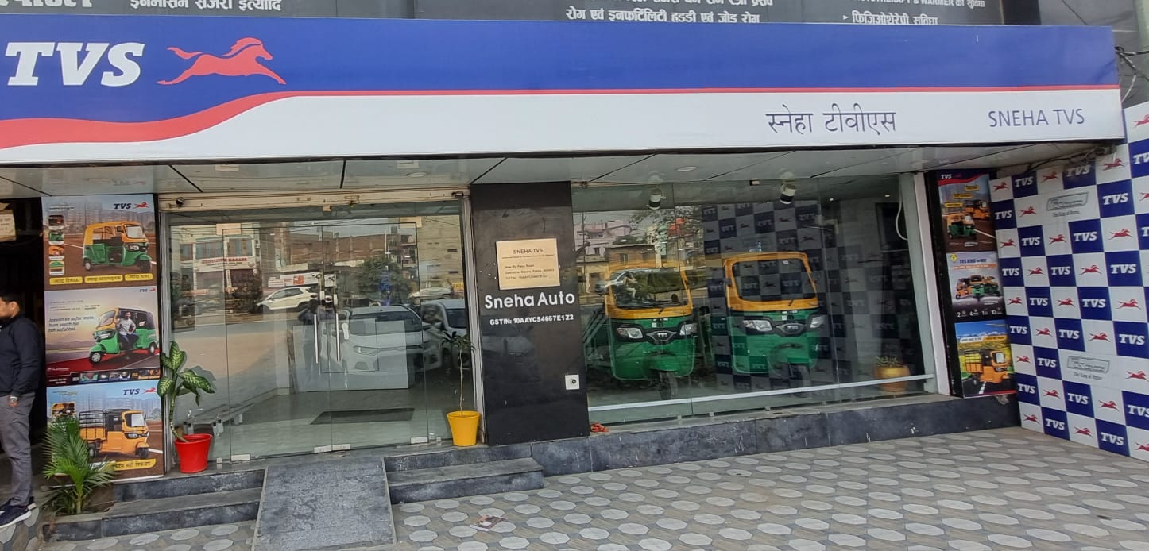
Introduction
About the Business :
Sneha Auto Pvt Ltd, established in 2018 by Mr. Sushant Shekhar, is a B2C dealership in Patna specializing in CNG rickshaw sales and servicing. Known for quality vehicles and reliable after-sales support.
Project’s Objective :
The objective of this project was to streamline inventory management at Sneha Auto Pvt Ltd, maximizing efficiency, profitability, and market reach through optimized inventory strategies.
Image 1 : Shop’s front image

Slide 3

Problem Statement
1.Inventory Management Challenge
The company faces overstocking of slow-moving models while running out of high-demand models, leading to increased costs and lost sales.
Optimizing inventory through better forecasting and procurement strategies is crucial.
2.Market Visibility Issue
Sneha Auto struggles with a lack of online presence and limited marketing efforts.
It restricting its reach to potential customers.

Slide 4
Structured Approach
Source of Information
Sales and purchase records from May 2024 to October 2024.
Microsoft Excel, Python (Matplotlib).
Tools Used
Key Methods
Demand and Supply Trends: Analyzing future sales and supply patterns to predict demand.
ABC Analysis – Categorizing stock based on value and turnover.
Real-Time Inventory Analysis: Continuously monitoring inventory levels and movements to optimize stock management.
Turnover Ratio Calculation – Measuring stock movement efficiency.

Slide 5
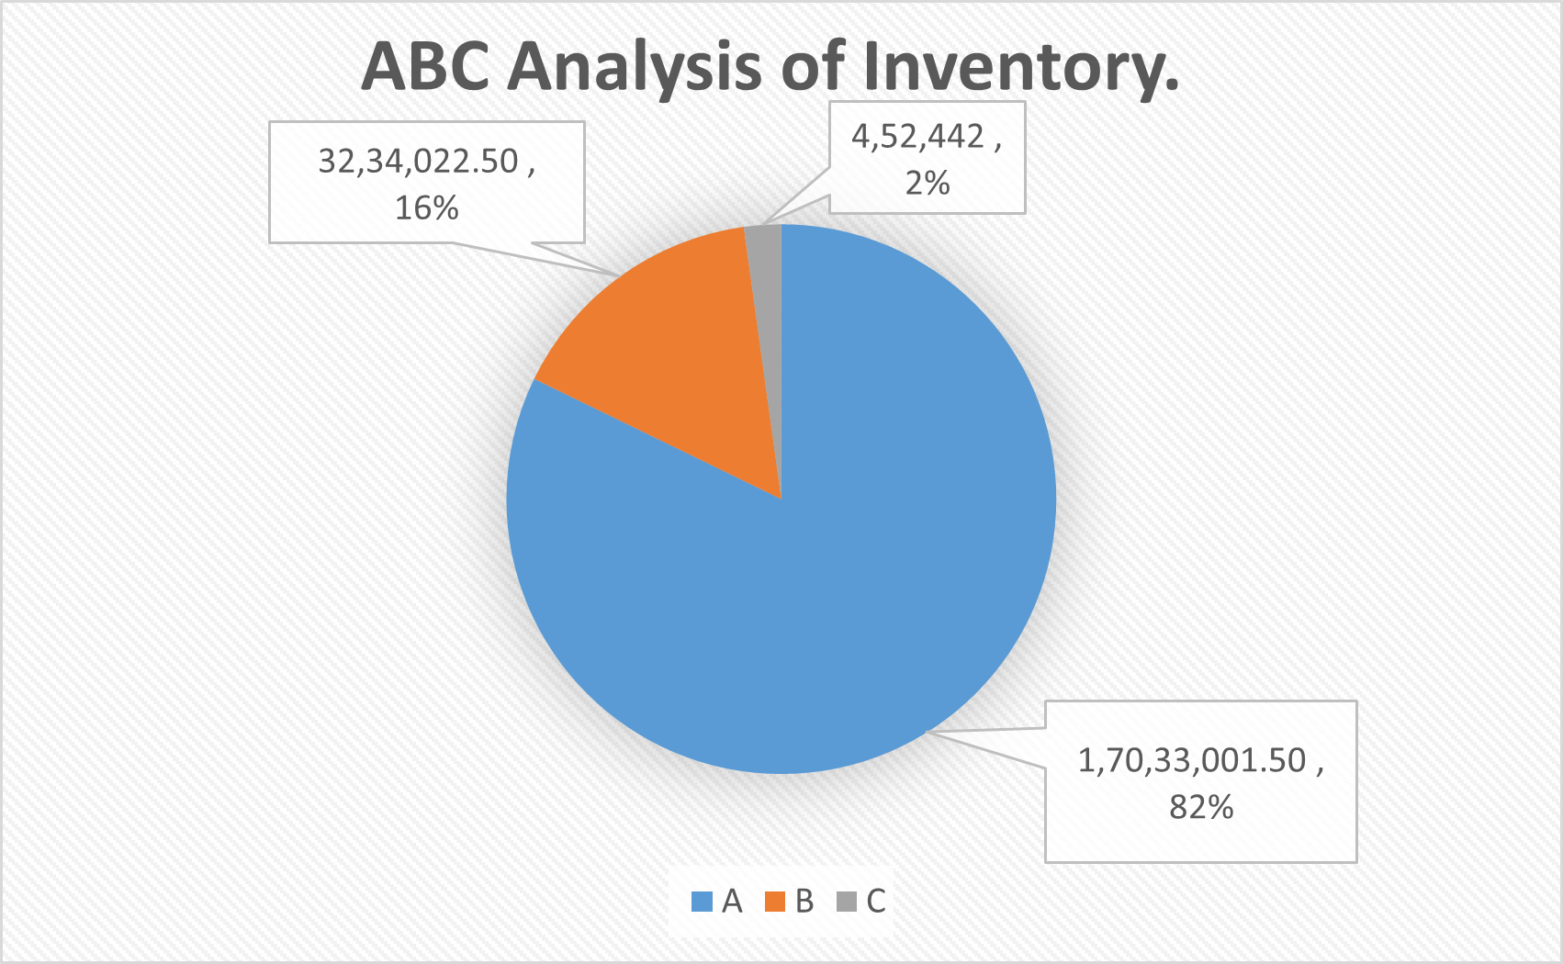
Inventory Classification
Category A
The TVS King Zs+Fi-BsVI 4sCNG 30Ltr, accounting for 82.22% of revenue, is crucial for sales and requires efficient stock management.
Category B
The TVS King Zd 225 Lc-Fi B-Duramax, contributing 15.59% to total revenue, plays a key role in profitability, requiring careful inventory management.
Fig 1 : ABC Inventory Classification: Contribution to Total Inventory Value
Category C
The TVS King Zk Fi Nf Wine, making up 2.19% of revenue, represents low-value, slow-moving products that require effective management to minimize waste and storage costs.

Slide 6
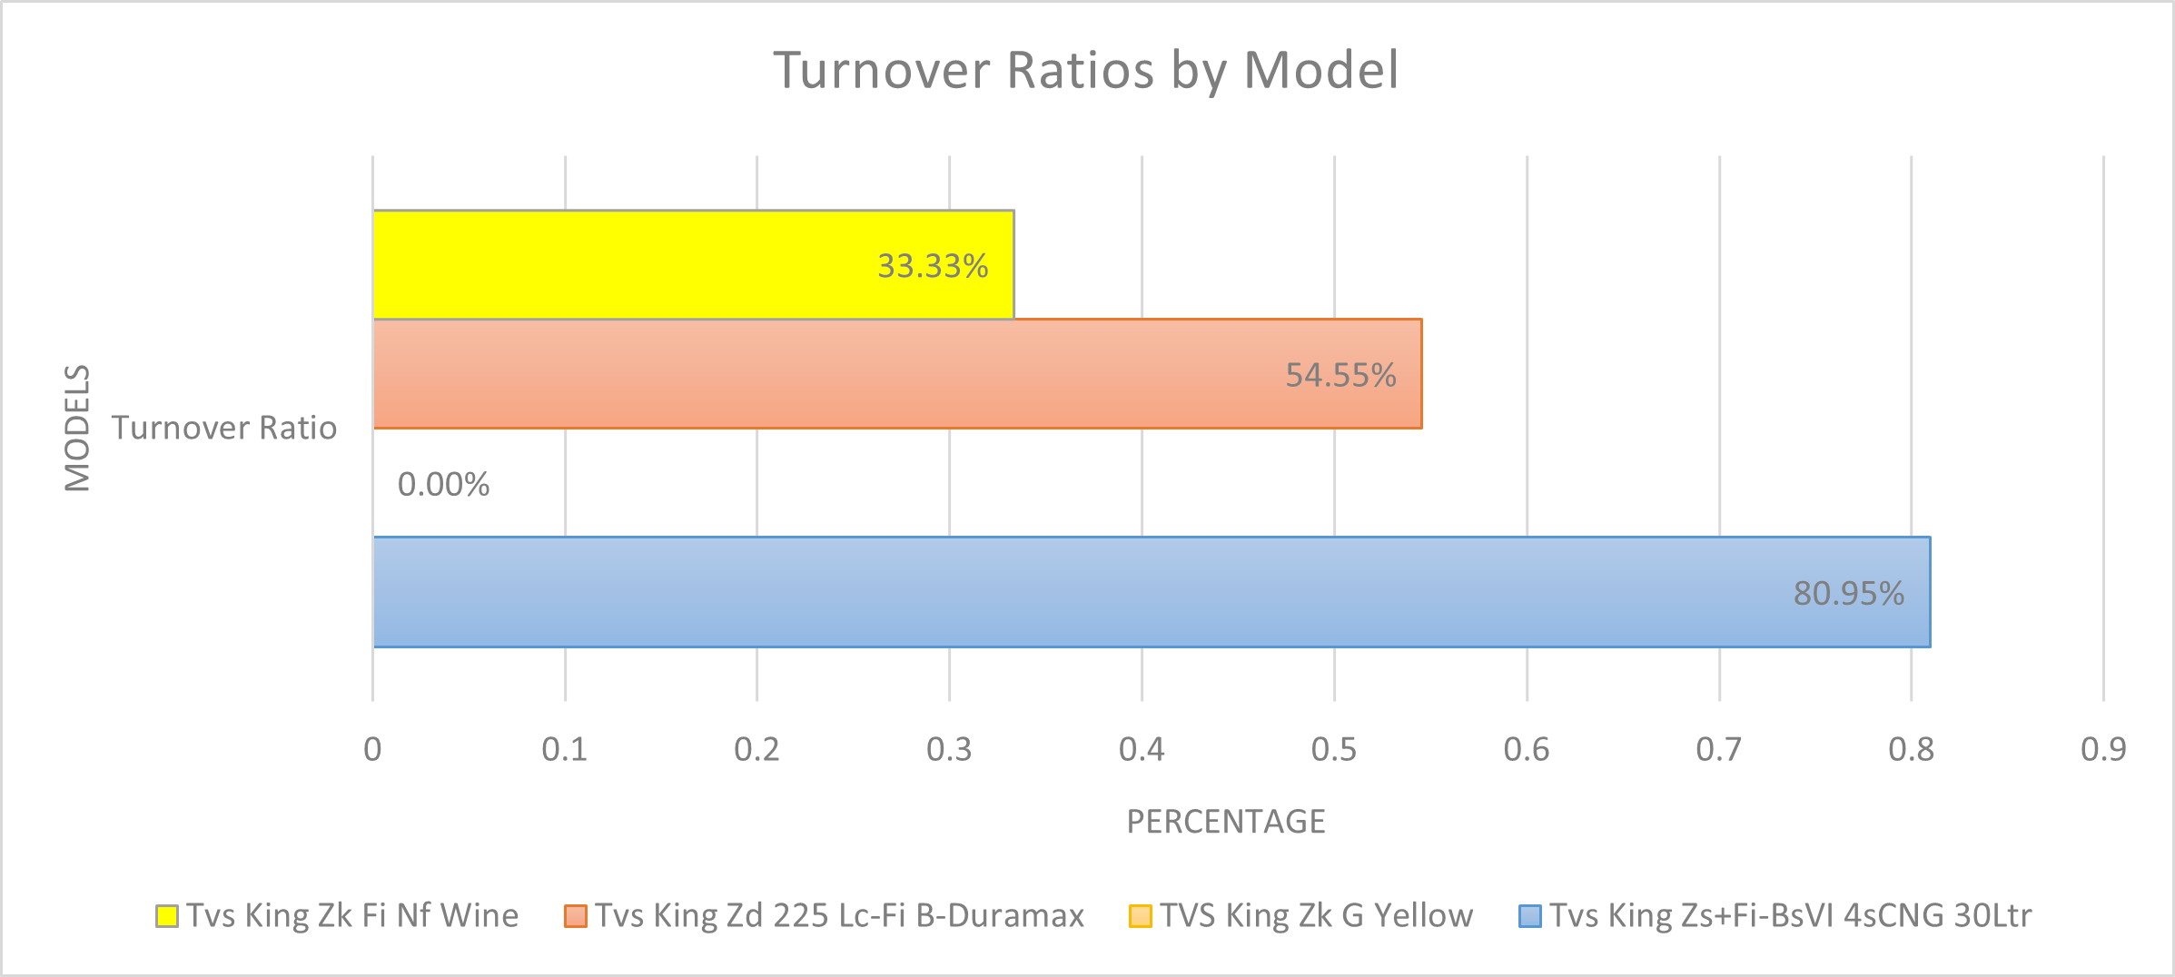
Inventory Turnover Insights
The TVS King Zs+Fi-BsVI 4sCNG 30Ltr has an 80.95% turnover ratio, reflecting strong sales and effective inventory management.
The TVS King Zd 225 Lc-Fi B-Duramax, with a 54.55% turnover, shows steady demand but needs strategic restocking.
Fig 2 : Inventory Turnover Ratio by Models
The TVS King Zk Fi Nf Wine's 33.33% turnover suggests low market demand and potential issues with marketing or customer preferences.
The TVS King Zk G Yellow's 0% turnover indicates no sales, requiring immediate attention due to poor market performance or strategy issues.

Slide 7
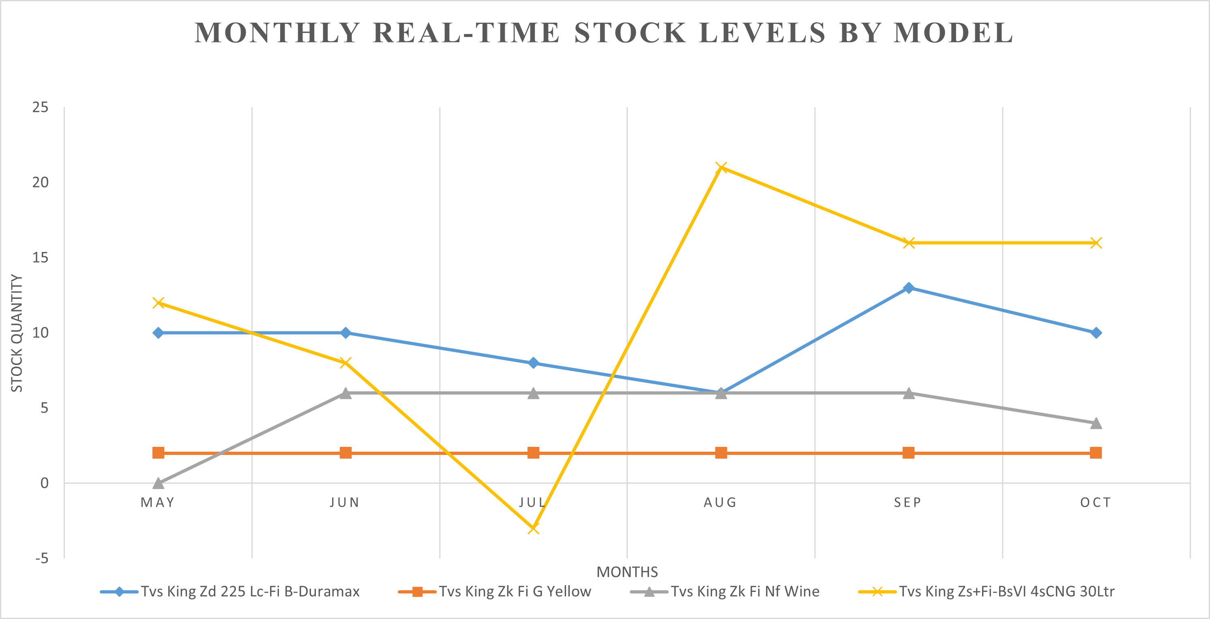
Real Time Inventory Insights
The TVS King Zs+Fi-BsVI 4sCNG 30Ltr (yellow line) shows significant fluctuations in stock, with a peak in August followed by a decline, indicating supply challenges and overstocking due to anticipated demand.
The TVS King Zk Fi Nf Wine (gray line) and TVS King Zk G Yellow (orange line) show minimal purchase and sales activity, reflecting stable but low demand.
The TVS King Zd 225 Lc-Fi B-Duramax (blue line) shows a progressive decline, indicating good sales but the need for improved stock replenishment to avoid shortages.
Fig3 : Monthly Trends in Real-Time Stock by Models

Slide 8
Demand vs. Supply Trends
In August, purchases spiked to 36 units versus 14 units of demand, possibly due to overestimated seasonal demand.
June's purchase surplus suggests overestimated demand and inaccurate forecasting, leading to excess stock.
October's balanced demand and purchases (27 vs. 24 units) indicate improved inventory management and forecasting.
June’s high purchases with low demand risk excess inventory, potentially increasing storage costs and straining working capital.
Fig4 : Monthly Trends in Demand vs. Supply

Slide 9
Recommendations
Optimize Inventory for High-Demand Models:
Maintain a 10% buffer stock for fast-selling models to prevent lost sales due to sudden demand spikes.
Reduce Overstocked Inventory
Implement targeted marketing campaigns, discounts, and bundle offers to clear slow-moving stock efficiently.
Improve Supply Chain Coordination
Shorten supplier lead times by improving logistics efficiency and adopting just-in-time inventory practices.
Enhance Demand Forecasting
Use advanced predictive analytics, incorporating seasonal trends, and historical data to improve demand accuracy.
Strengthen Digital Presence
Expand online reach through social media, e-commerce, and digital marketing to drive sales and engagement.

Slide 10
Conclusion
Stock Optimization
Stock optimization boosts market presence and financial performance by ensuring high-demand models are always available, increasing customer satisfaction and sales
Efficient Inventory Management
Efficient inventory management reduces costs and maximizes profits by minimizing overstocking, improving cash flow, and lowering operational expenses.
Implementing Recommendations
Implementing recommendations drives long-term business growth through data-driven forecasting, better supplier coordination, and an enhanced digital presence.

Slide 11
Thank You
Name : Aayush Krishna
Roll Number : 23F1002879
Email : 23f1002879@ds.study.iitm.ac.in

